Slide 1
Face Emotion Recognition Using Machine Learning
Presenter: Jawwad Ahmed ~ 367061

Slide 2
What does it do?
The project utilizes machine learning to classify facial expressions into seven emotions from a dataset of around 36,000 images, aiming to create an accurate facial emotion recognition in real time system with applications in sentiment analysis and human-computer interaction.

Slide 3
Base Idea & Inspiration
From a YouTube video: https://www.youtube.com/watch?v=aoCIoumbWQY
Python
Machine Learning
Datasets (https://www.kaggle.com/datasets/jonathanoheix/face-expression-recognition-dataset)

Slide 4
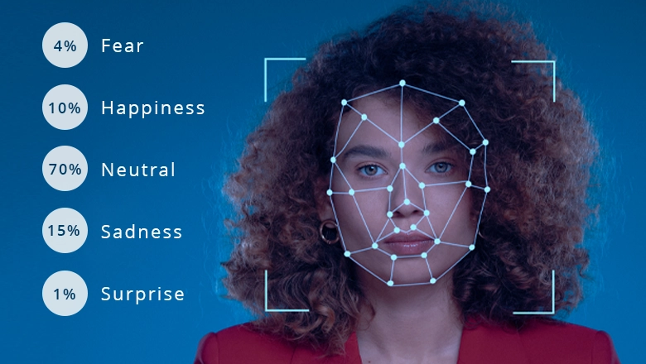
Methodology

Slide 5
Requirements:
TensorFlow: For building complex neural networks efficiently.
Keras: Quick and easy neural network prototyping.
Pandas: Data organization and manipulation.
NumPy: Efficient handling of numerical data.
Jupyter: Interactive coding and visualization.
Notebook: Documenting and sharing code with explanations.
Tqdm: Tracking progress during tasks.
Opencv-contrib-python: Image preprocessing and feature extraction.
Scikit-learn: Implementing machine learning algorithms swiftly.
Matlibplot: To plot images on graph.

Slide 6
Emotions Included:
Happy
Sad
Neutral
Disgust
Angry
Fear
Surprise

Slide 7
Methodology for Model Training (ipynb):
Data Preparation:
Load Images
Create Data frames
Feature Extraction:
Grayscale Conversion
Normalization
Model Construction:
Define Architecture
Add Layers
Model Training:
Compile Model
Fit to Data
Model Evaluation and Saving:
Evaluate Performance
Save Model
Model Loading and Prediction:
Load Saved Model
Predict Emotions

Slide 8
Methodology for Realtime Implementation (py):
Capture Video:
Pre-process Image:
Detect Faces
Extract Features:
Load Model:
Predict Emotions:
Display Output:
Handle Errors:
Identify facial regions.
Resize detected face.
Load emotion detection model.
Utilize model.
Draw rectangles, overlay emotions.
Implement error handling.
Convert to grayscale, detect faces.
Access webcam.

Slide 9
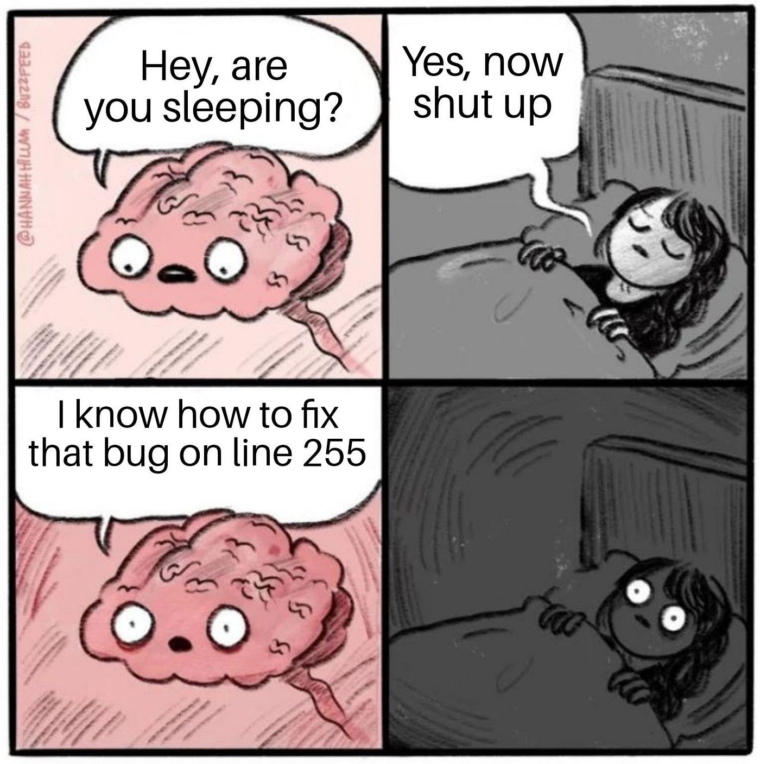
Errors

Slide 10
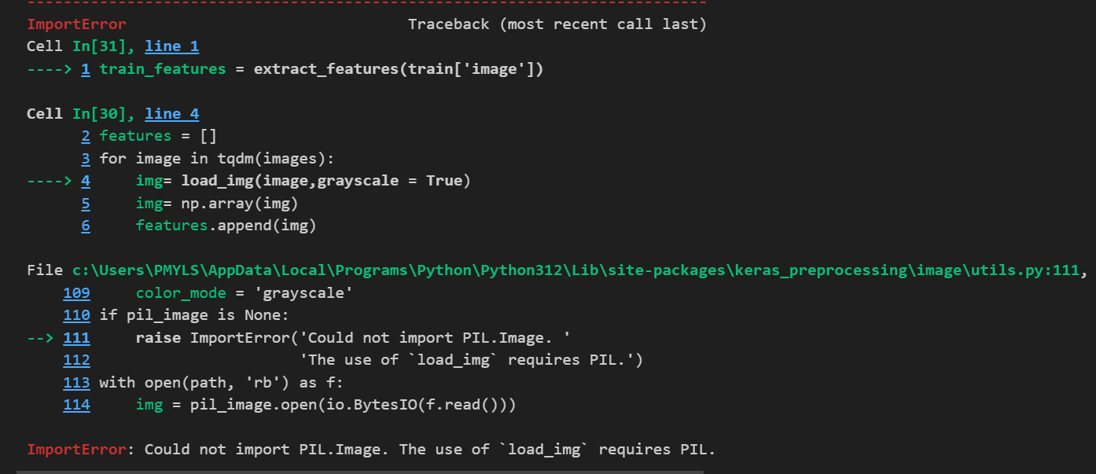
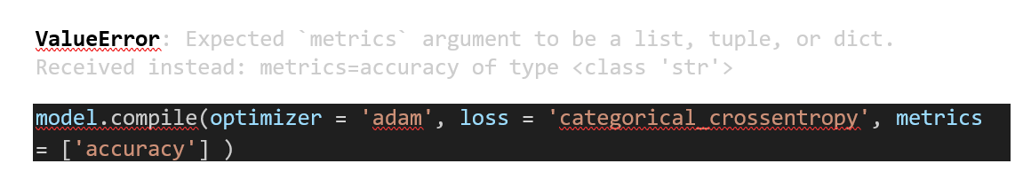
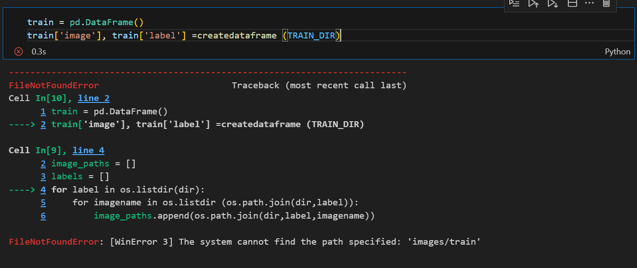
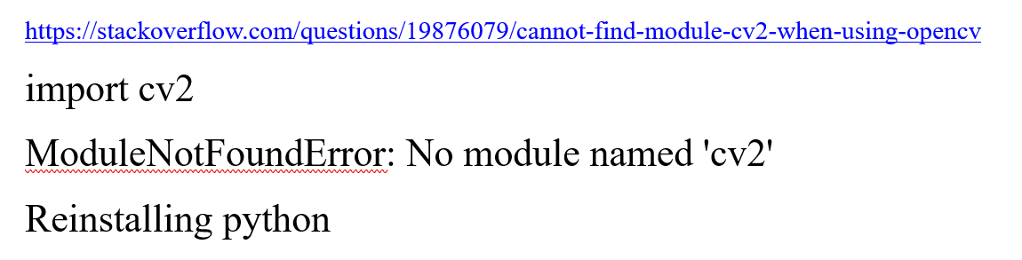
Virtual and Global Environments

Slide 11
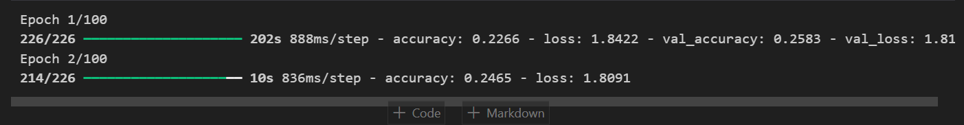
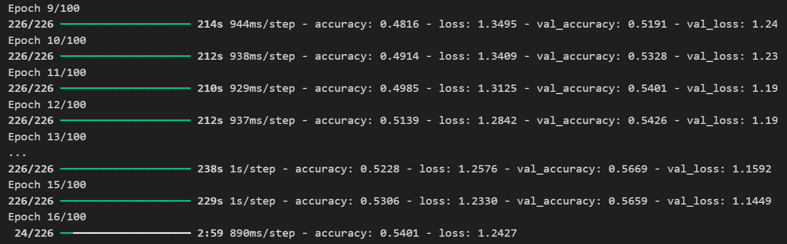
Model Training
And More!!!

Slide 12
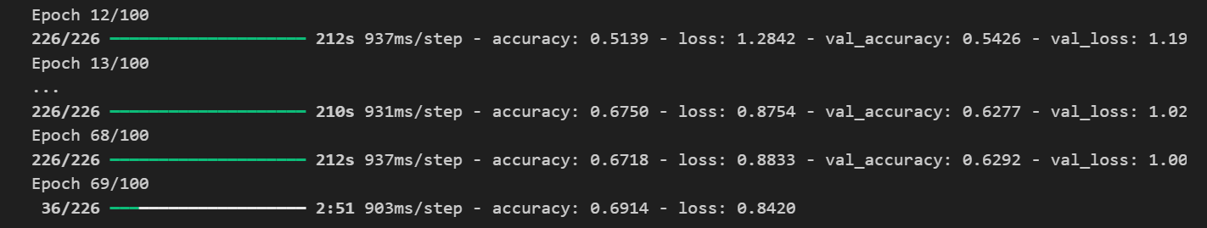
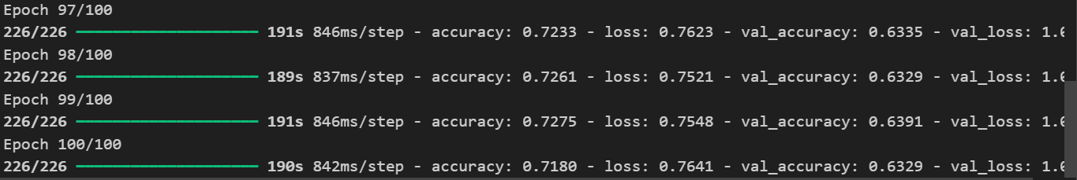
Can it be faster?
Not so fast

Slide 13
Finally!!!
389 minutes
Accuracy: 71.89% vs 62.00% of the base project ~ Proportion
Loss: 0.7641 (Minimization of prediction error.)

Slide 14
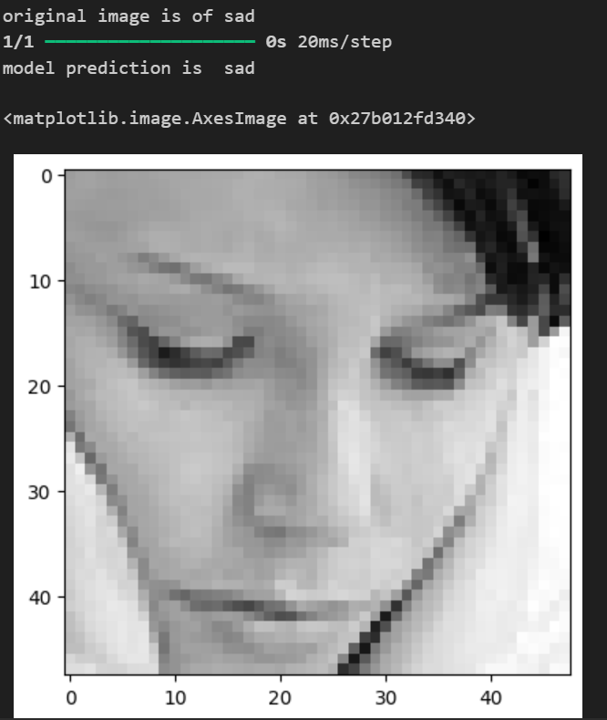
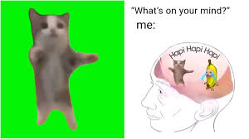
Results:

Slide 15
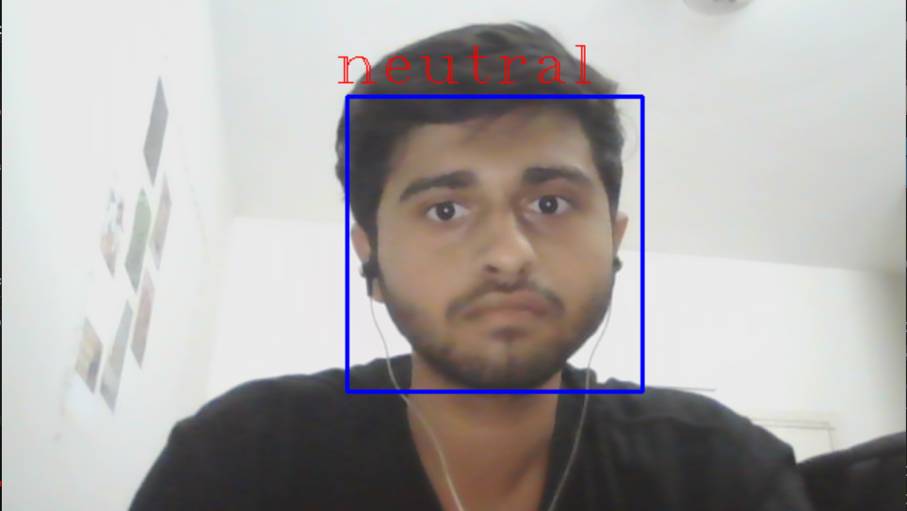

Slide 16
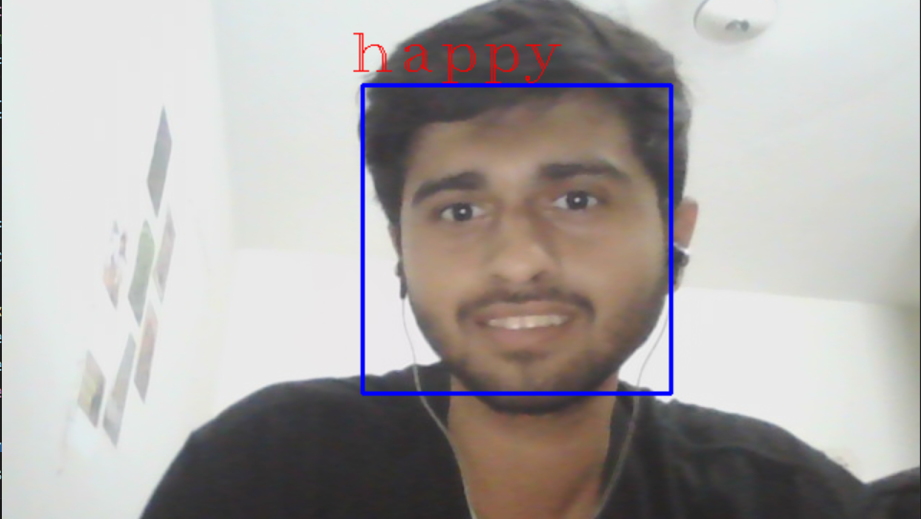

Slide 17
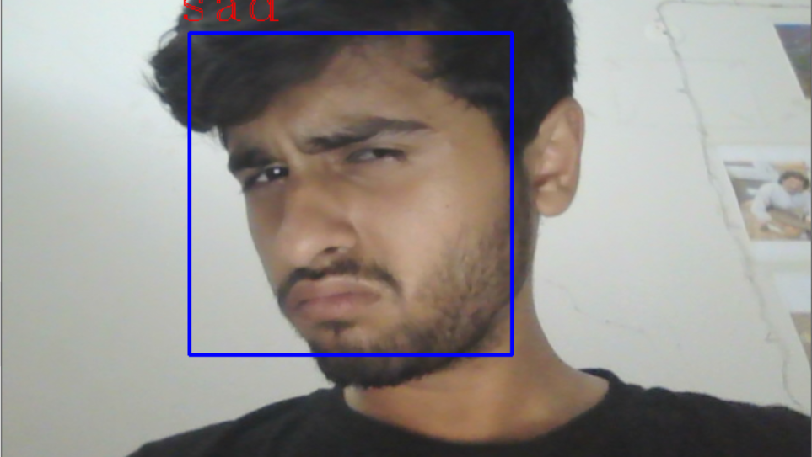

Slide 18
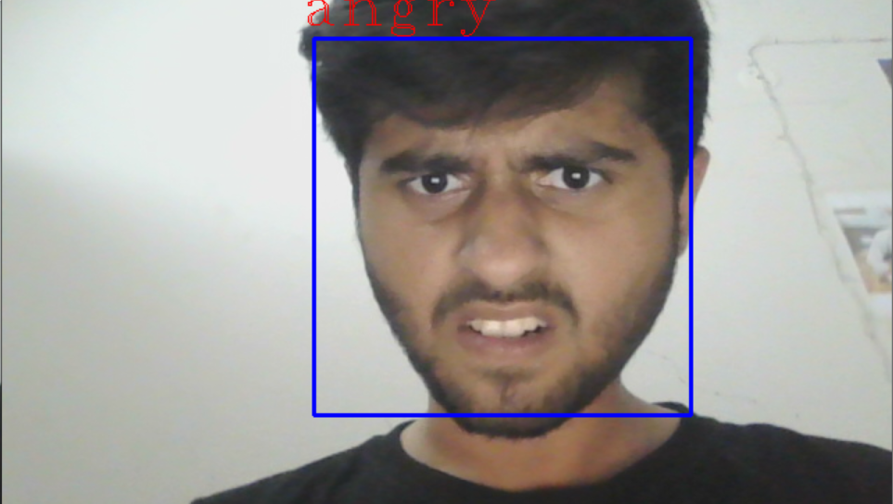

Slide 20
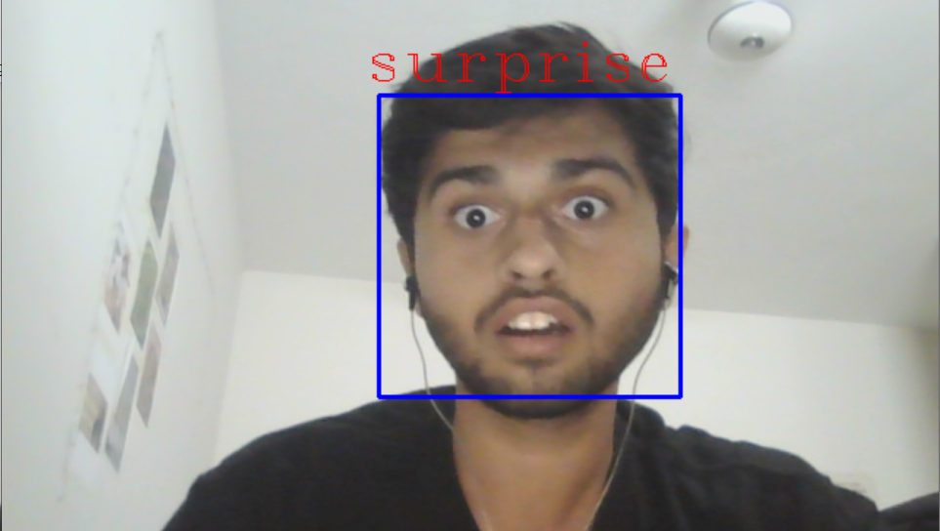

Slide 21
The Last Expression??
I made a million weird faces!!!
Well, the model was not that accurate ☹

Slide 22
Limitations
Limited diversity in training data.
Insufficient computational resources for complex models.
Unbalanced class distribution in the dataset.
Reshaping and Resizing.
Low quality grayscale images in data set.
Noisy or inconsistent labeling of the data.
Hardware limitations affecting training speed and efficiency.
Difficulty in capturing subtle variations or nuances in data.

Slide 23
Github Link:
https://github.com/Jawwad-Ahmed-225/CS-371

Slide 24
Thank you

